Slide 1
生成式AI技術與數位行銷人才養成班
人工智慧概論
謝欽旭
國立高雄科技大學電子工程系
2025

Slide 2
STATISTICAL ARTIFICIAL INTELLIGENCE
In the 1990s many researchers grew frustrated by the shortcomings of classical Al, with its focus on logic and deductive reasoning, and began developing statistical techniques instead.
Machine learning involves using data sets to train Ai models (including models that mimic the human brain, known as "artificial neural networks") to perform tasks without requiring an engineer to program them explicitly to do so.
This approach is thriving today, due to the availability of powerful computer hardware and large data sets.

Slide 3
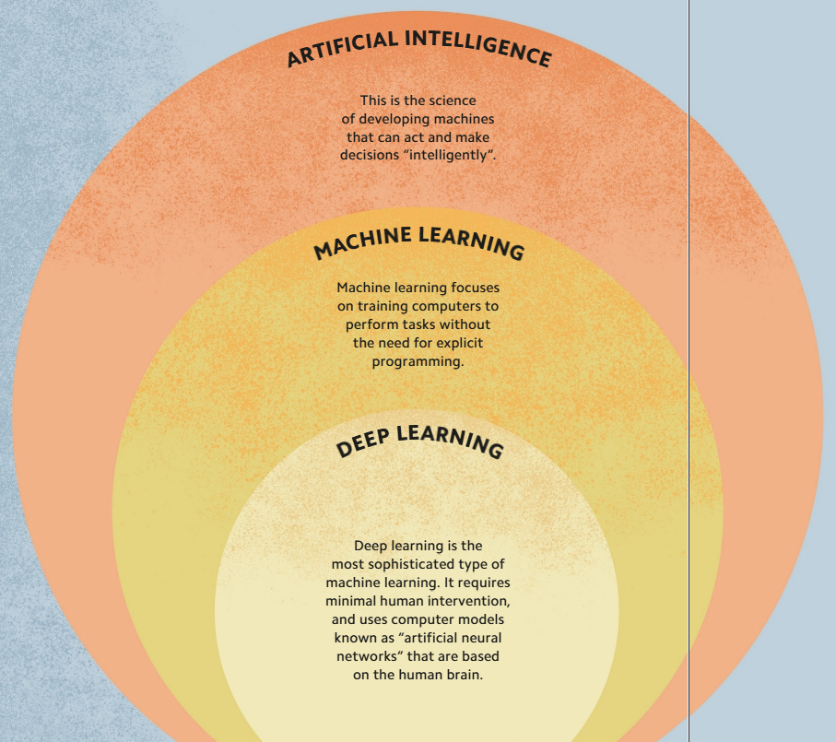
TEACHING Als TO THINK - MACHINE LEARNING
Machine learning is a form of Al that enables computer systems to learn how to perform tasks without being explicitly programmed to do so.
For more complex tasks, such as recognizing faces or understanding spoken conversations, it is incredibly difficult for programmers to write the necessary algorithms, and this is where machine learning comes in.
Machine-learning algorithms use collections of sample data, known as training data, to build models that make predictions or choices based on new data.

Slide 4
GAINING INSIGHT FROM DATA - DATA MINING
Data mining is a process of uncovering patterns of information in large data sets (sets of information) with a view to making the data useful for specific tasks.
Data mining is a broad discipline that increasingly uses Al techniques to process volumes of data that are too large for humans to handle.
Two key techniques used are “clustering” and “anomaly detection.”

Slide 5
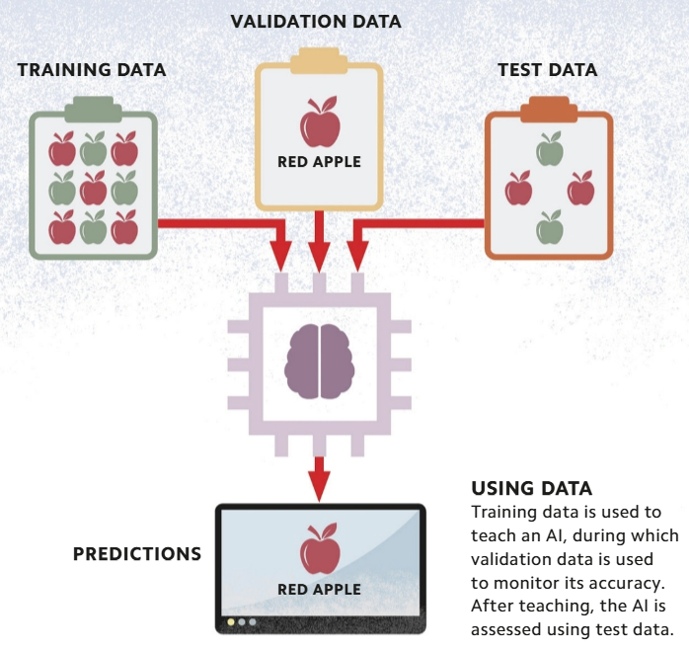
TEACHING MATERIALS - TRAINING DATA
Training data is a type of data that is used during machine learning to teach Als how to perform tasks accurately.
"Validation data'' may also be used to assess how accurately the Al processes the training data during the learning period.
Once the Al has been trained, "test data" is then used to assess the accuracy of its results.

Slide 6
GIVING DATA MEANING - FEATURES AND LABELS
A "feature" is a characteristic, such as a pattern of pixels, that an Al can use as an input to predict a label, which becomes the output.
In supervised machine learning, Als learn to associate particular features with labels by processing training data sets that have already been labeled by a human operator.

Slide 7
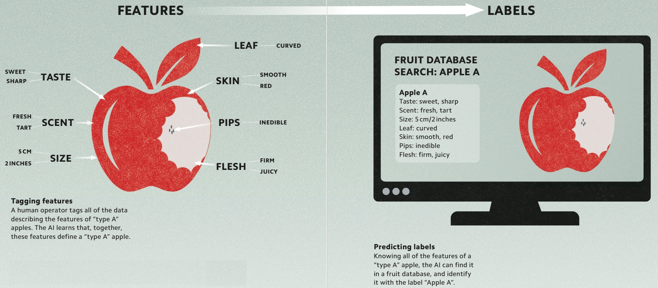

Slide 8
LOOKING FOR PATTERNS - PATTERN RECOGNITION
Pattern recognition, which enables Als to find answers within huge quantities of data, is one of the most versatile tools in machine learning.
Pattern recognition can involve finding and sorting data into defined classes or grouping similar data more loosely into “clusters”
It can also be used to identify how changing the inputs within an Al model will affect outputs, which is known as “regression.”

Slide 9
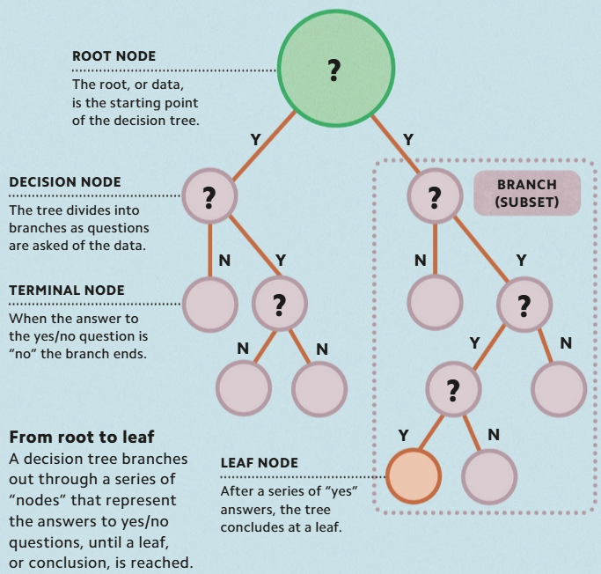
YES OR NO? - DECISION TREES
A decision tree is a model of the decision-making process used by Als.
One kind of decision tree is the "classification tree."
By repeatedly posing yes/no questions, the Al splits the “root” (data set) into ever-smaller “branches” (subsets) that share particular features, until a single “leaf” (conclusion) is reached, pinpointing a specific classification within the data.

Slide 10
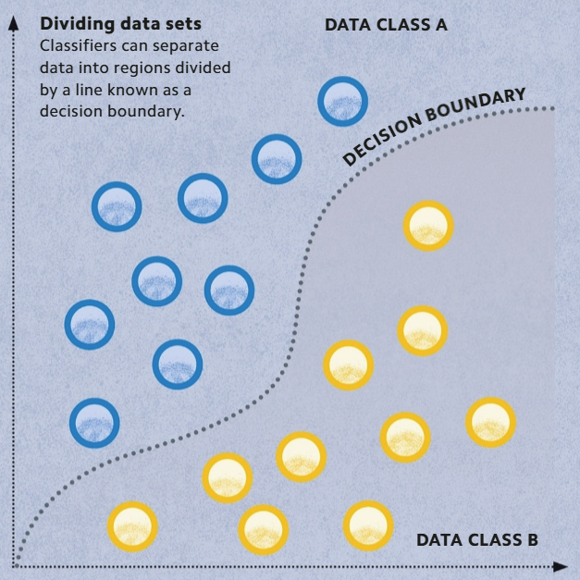
TYPES OF DATA - CLASSIFICATION
An algorithm that assigns labels to items and then sorts them into categories, or "classes," is known as a "classifier."
Through a process of supervised learning, Als are taught to classify items using a labeled training data set.

Slide 11
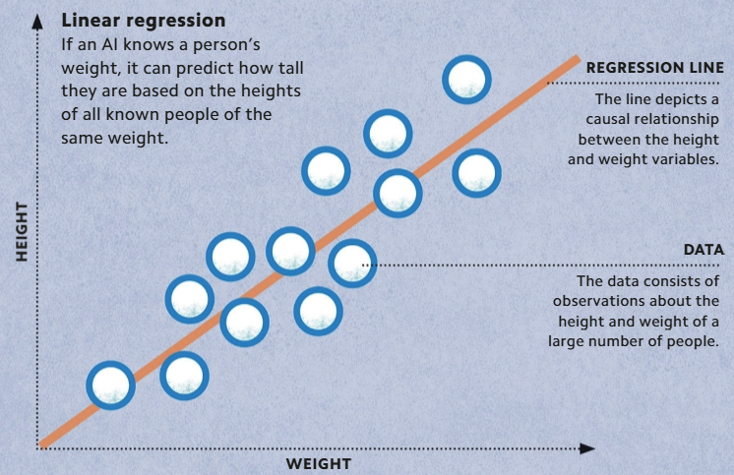
THE LINE OF BEST FIT - REGRESSION
Regression analysis is a machine-learning process in which an algorithm is used to predict the behavior of one or more variables depending on the value of another variable.
It is used in many supervised learning applications, particularly those that are designed to find causal relationships between several variables.
"Linear regression" is the most common form of regression analysis

Slide 12
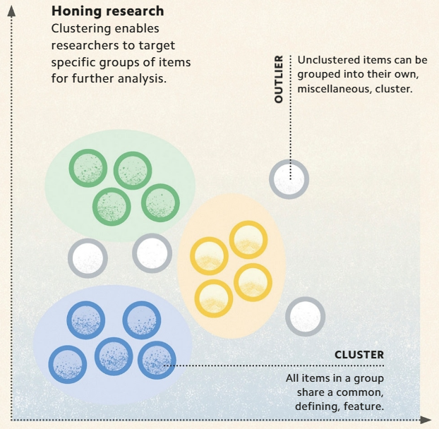
GROUPING DATA - CLUSTERING
Clustering is the process of dividing a data set into a number of groups based on commonly shared features.
It is an unsupervised machine-learning technique, which means that it is performed by Als on raw, unlabeled training data sets.

Slide 13
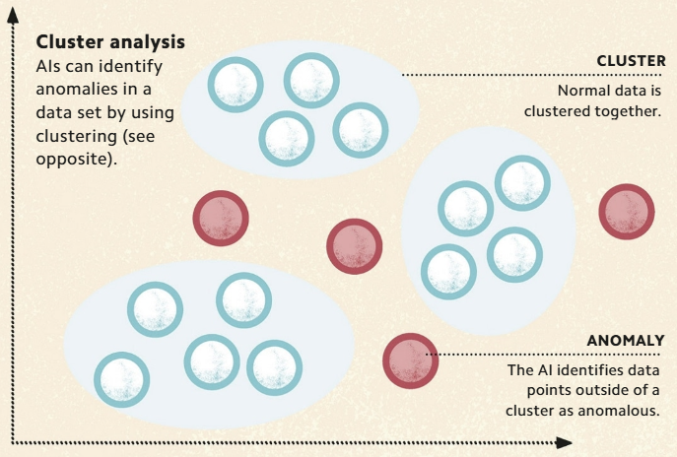
THE ODD ONE OUT - ANOMALY DETECTION
Anomaly detection is the process of identifying unusual (or "anomalous") data in a data set.
That is to say that the Al looks for items that do not fit a particular pattern or model built from its training data.
Many anomalies are caused by mistakes in the data, such as incorrectly inputted units, or an inconsistency in the type of measurement used.
However, anomalies can also draw attention to serious problems that lie outside the data set.

Slide 14
THE MOST LIKELY OUTCOME? - PREDICTIONS
Machine-learning models can make predictions by analyzing patterns in historical data.
In Al, a prediction is the output from a model that forecasts the chances of a particular outcome.
Al does not always involve anticipating a future event It can also be used to make "guesses" about events in the past and present.

Slide 15
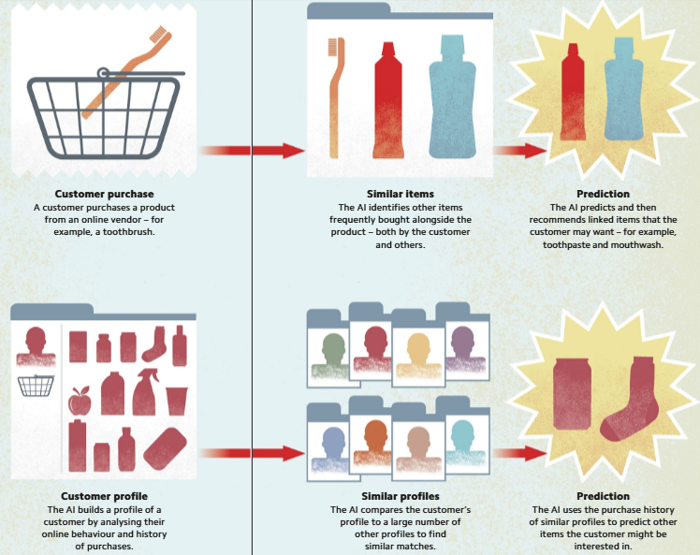

Slide 16
MACHINE LEARNING WITH "LABELED" DATA - SUPERVISED LEARNING
Supervised learning is a type of machine learning in which an Al is trained using a "labeled" training data set.
Input and output data is labeled by a human so that the Al can learn the relationship between them.
The inputs, outputs, and the rule that relates them are collectively known as a "function".
During training, are adjusted to make the function fit the training data.
The resulting function can be used to predict outputs based on new inputs.
Supervised learning can be used for classification and regression.

Slide 17
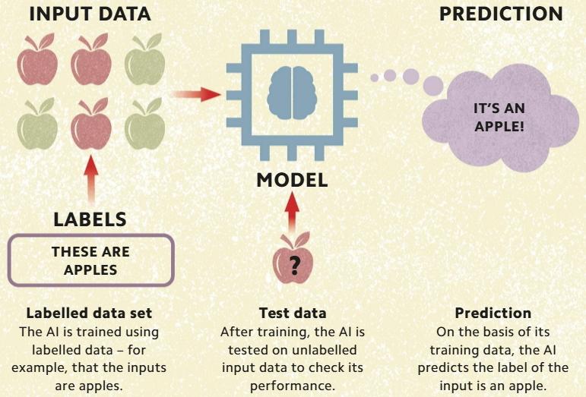

Slide 18
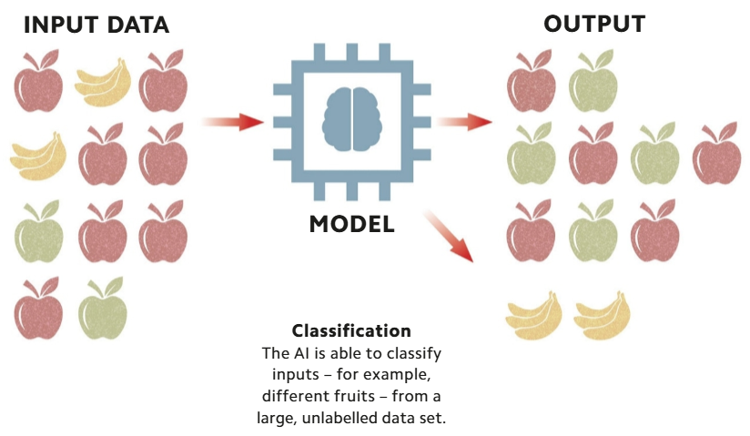
Unsupervised learning is used to discover hidden structures in raw, unlabeled data sets.
Although Als do not understand the relevance of these structures, they may still have real-world meaning.
This approach is useful in the early stages of data mining, to find patterns in large, unlabeled data sets, which can then be subject to human interpretation.

Slide 19
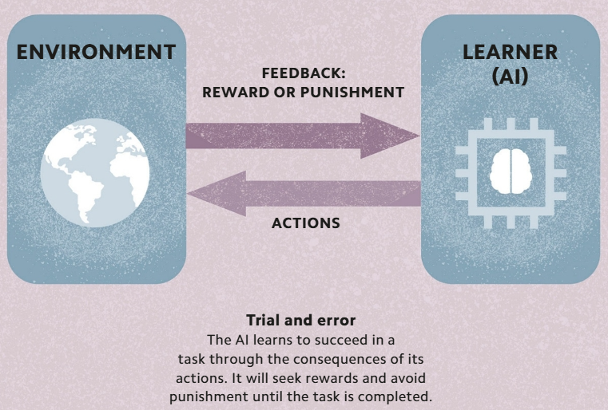
LEARNING FROM FEEDBACK - REINFORCEMENT LEARNING
Reinforcement learning is an approach to machine learning in which an Al is taught to perform a task through trial and error.
To achieve this, the Al is programmed to recognize "rewards" and "punishments," meaning positive or negative feedback, depending on whether it succeeds or fails.
The Al learns that succeeding is good and failing is bad, and repeatedly attempts the task until it is rewarded.

Slide 20
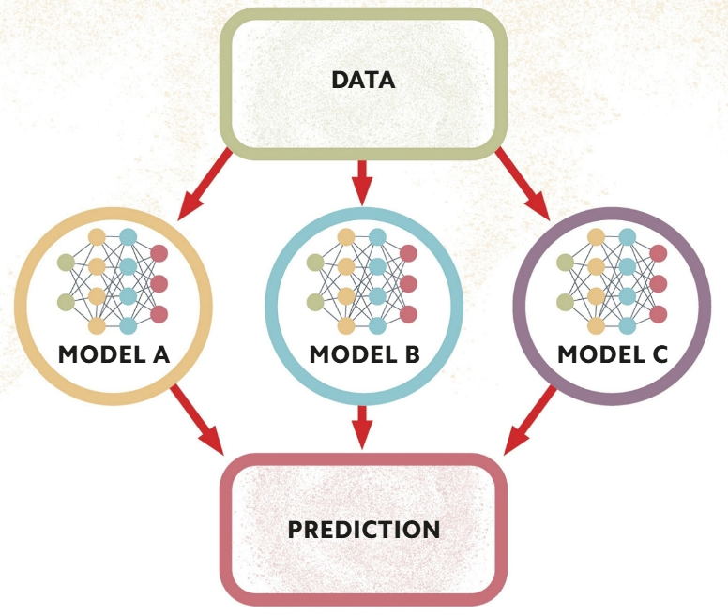
WORKING TOGETHER - ENSEMBLE LEARNING
Ensemble learning is based on the idea that combining the outputs of multiple machine-learning algorithms produces a better result than a single model can.
Using two or more models that have been built and trained in different ways, for example with different data sets, can "cancel out" their individual weaknesses and generate more accurate predictions.

Slide 21
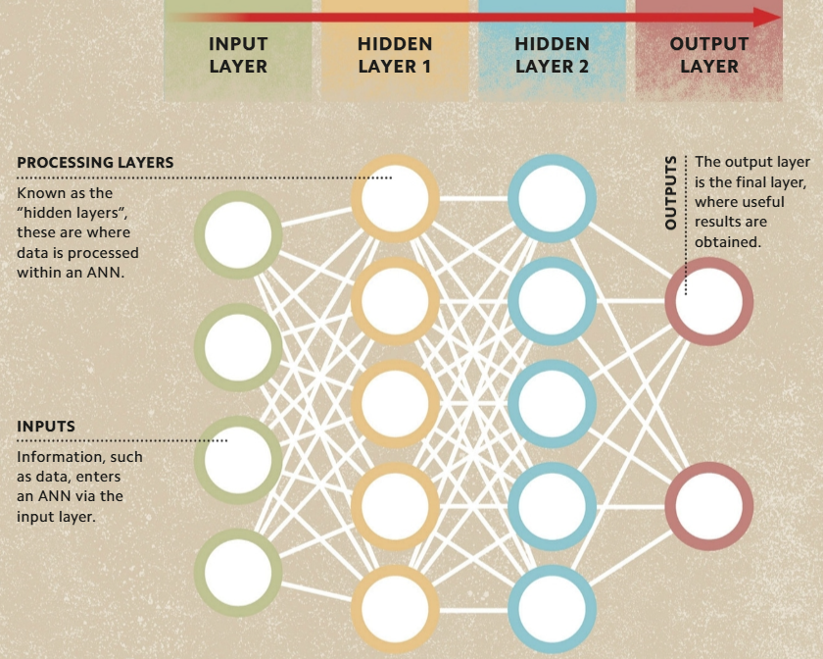
THE Al BRAIN - ARTIFICIAL NEURAL NETWORKS
Artificial neural networks is similar to that of the brain, consisting of interconnected nodes—artificial neurons—that are organized into multiple "layers".
The nodes within each layer receive, process, and send data to the next layer in the network, until an output, or result, is produced.
Using training data, programmers can teach an ANN to "learn“ how to give the expected results, or outcomes.

Slide 22
NETWORK STRUCTURE - LAYERS
Artificial neural networks (ANNs) are structured in "layers"—collections of processing nodes that operate together.
Data flows from the nodes in one layer to those in the next.
  The first layer always contains the "input," or incoming data.
  Next is at least one "hidden“ layer, in which the processing takes place. These layers are hidden in the sense that their data is not visible to a user in the way that the network's inputs and outputs are.
  Finally, the resulting data arrives at the "output" layer.
All ANNs share this basic structure, but some are more complex: recurrent neural networks (see p.85) generate connections between nodes in the next or in previous layers, while deep neural networks (see p.86) can have hundreds of hidden layers.

Slide 23
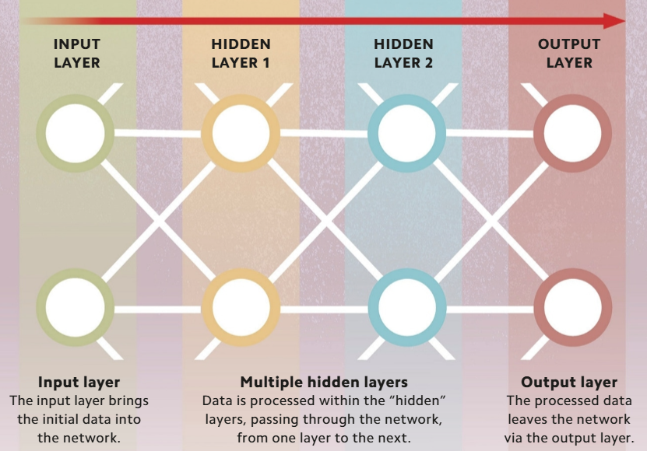

Slide 24
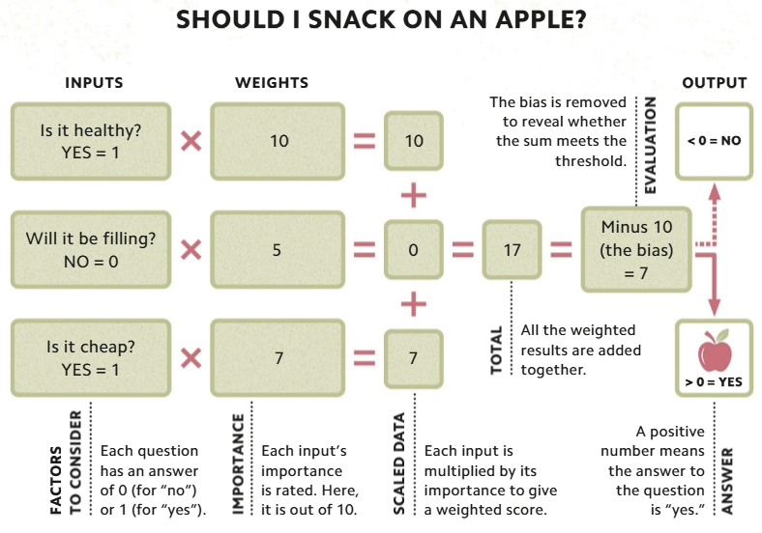
ASSIGNING IMPORTANCE - WEIGHTING
When designing and training an ANN, programmers can give these variables greater or lesser influence within the algorithm.
This influence is known as "weight." The more weight an input has, the greater its influence over the output.
The "bias" (see opposite) determines the threshold at which variables become significant.
Adjusting the weights and bias allows the ANN to be fine-tuned to give more accurate results.

Slide 25
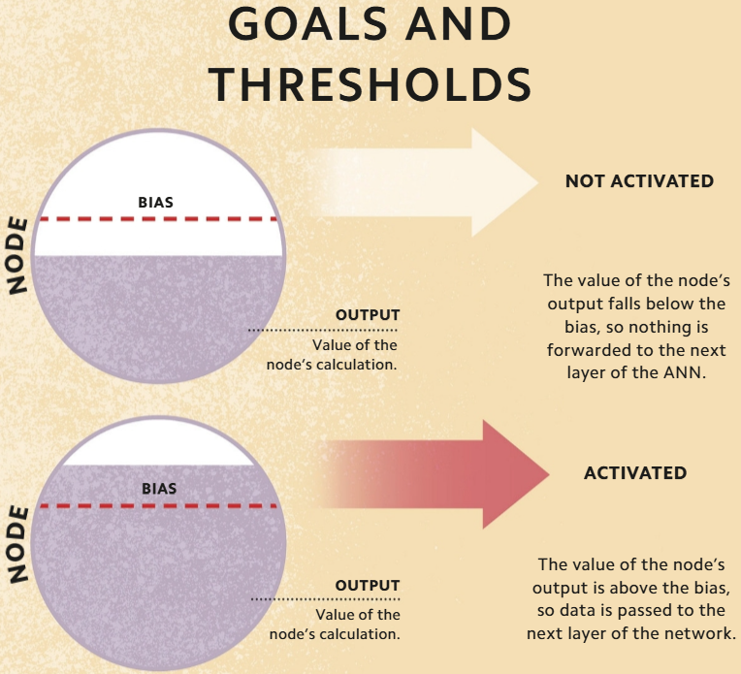
GOALS AND THRESHOLDS - BIAS
An artificial neural network (ANN) is made up of layers of "nodes," which receive and process data. Before a node can pass information on to the next layer of nodes, its output data must reach a certain value.
This value—essentially a numerical score set by the ANN designer—is known as the "bias." The node can only "activate" and pass on its output data once the bias has been met. If the node is not activated, that path of data transmission stops

Slide 26
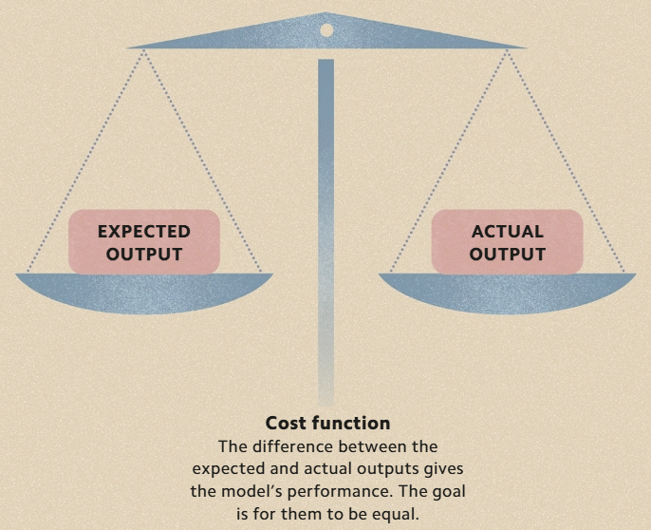
MEASURING SUCCESS - COST FUNCTION
The performance of a machine-learning model, such as an artificial neural, can be evaluated by its "cost function. "
This is a measure of the change that occurs during training between the actual outputs from the model and the outputs expected by the programmer.
This difference, called the "cost," is expressed as a number. The higher the number, the greater the gap between the real and the anticipated outputs, and the poorer the model.

Slide 27
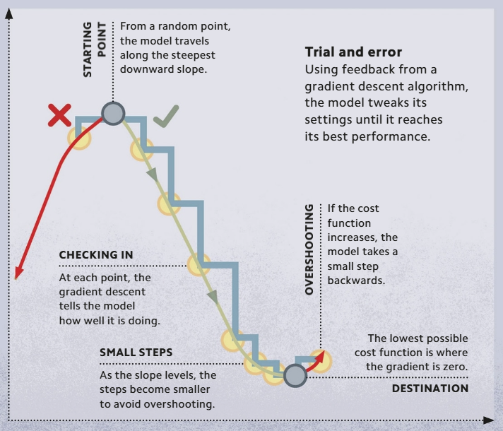
IMPROVING PERFORMANCE - GRADIENT DESCENT
A machine-learning model improves its performance by fine-tuning its settings.
The algorithm that trains it to do this is known as the "gradient descent." Each time the model adjusts its settings, the gradient descent rates its success using the "cost function" (see opposite).

Slide 28
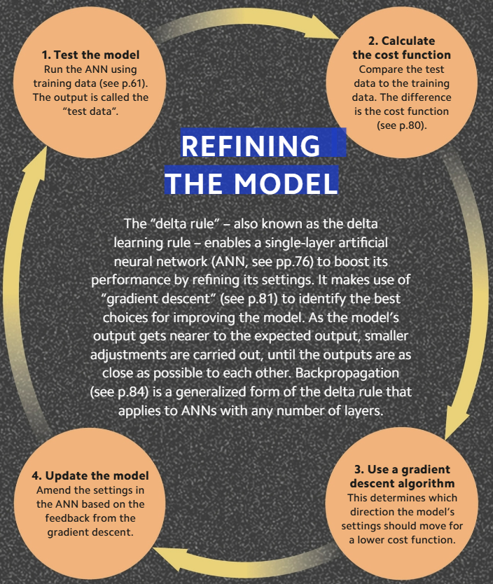
REFINING THE MODEL - THE DELTA RULE
The "delta rule"—also known as the delta learning rule—enables a single-layer artificial neural network (ANN, see pp.76) to boost its performance by refining its settings.
It makes use of "gradient descent" (see p.81) to identify the best choices for improving the model.

Slide 29
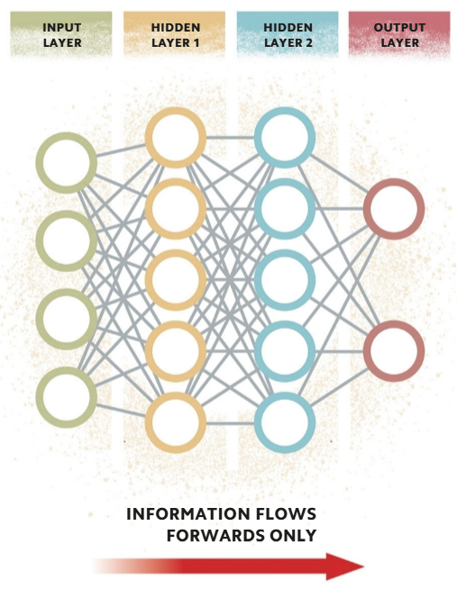
A ONE-WAY NETWORK - FEEDFORWARD NEURAL NETWORKS
A "feedforward neural network" (FNN) is a simple artificial neural network (ANN, see p.76) in which information flows forward only—from the input layer, through the hidden layers, to the output layer.

Slide 30
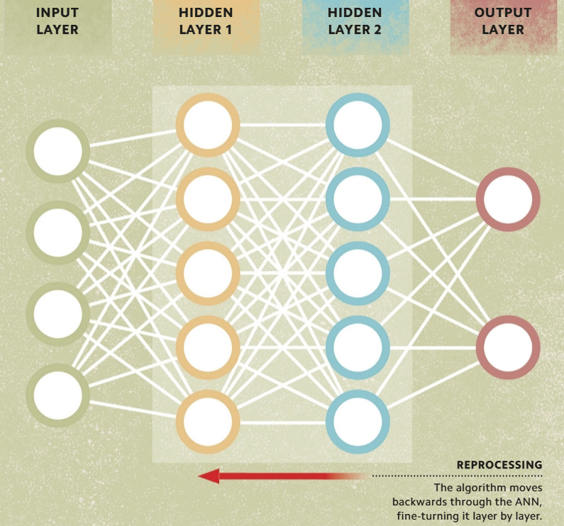
FINE-TUNING DATA - BACKPROPAGATION
Backpropagation is a type of algorithm that is used to train artificial neural networks (ANNs), specifically feedforward neural networks.
It is known as backpropagation because it begins at the final (output) layer and moves in reverse towards the first (input) layer.
During this process, nodes are reprogrammed by adjusting their weights and biases using gradient descent to find out whether increasing or decreasing them will produce better results

Slide 31
STRUCTURED DATA - RECURRENT NEURAL NETWORKS
A recurrent neural network (RNN) is a type of ANN in which data can move backward in a "feedback loop".
RNNs are used to process sequential data—data that has to be in a specific order—such as language.
While traditional ANNs process individual data points to give an outcome, RNNs maintain the essential structure and relationships within sequential data, so that it remains intact.
In doing so, RNNs can be used to predict the next output of a sequence They are used widely in natural language processing tasks, including training virtual assistants to carry out spoken conversations.

Slide 32
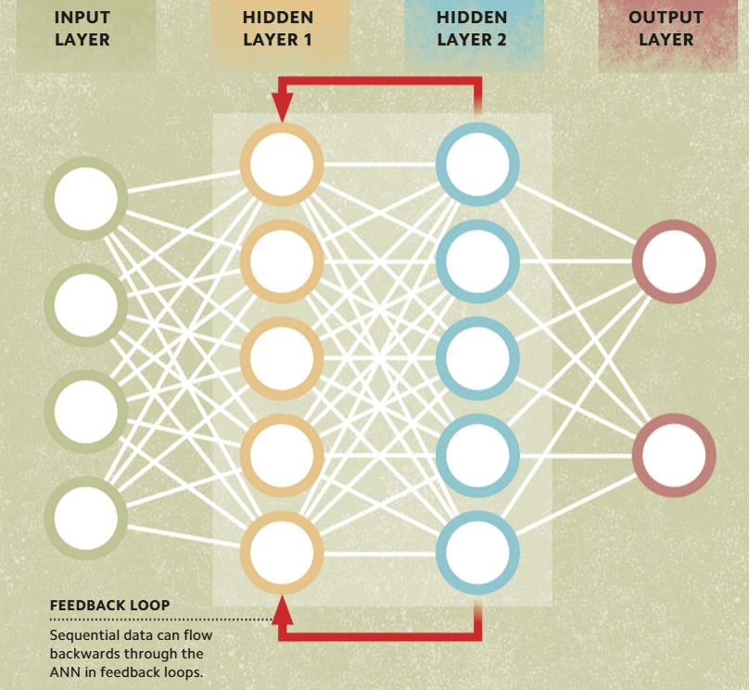

Slide 33
BUILDING A BRAIN – DEEP LEARNING
Deep learning is a powerful form of machine learning based on artificial neural networks. It uses ANNs with many hidden layers, known as deep neural networks (DNNs), to identify increasingly more meaningful features from input data.
As with ANNs, data passes from the input layer into the hidden layers, where the nodes receive, process, and pass it on to another node in the next layer.
With so many layers, DNNs process data very accurately and quickly, and are also capable of making accurate predictions.

Slide 34
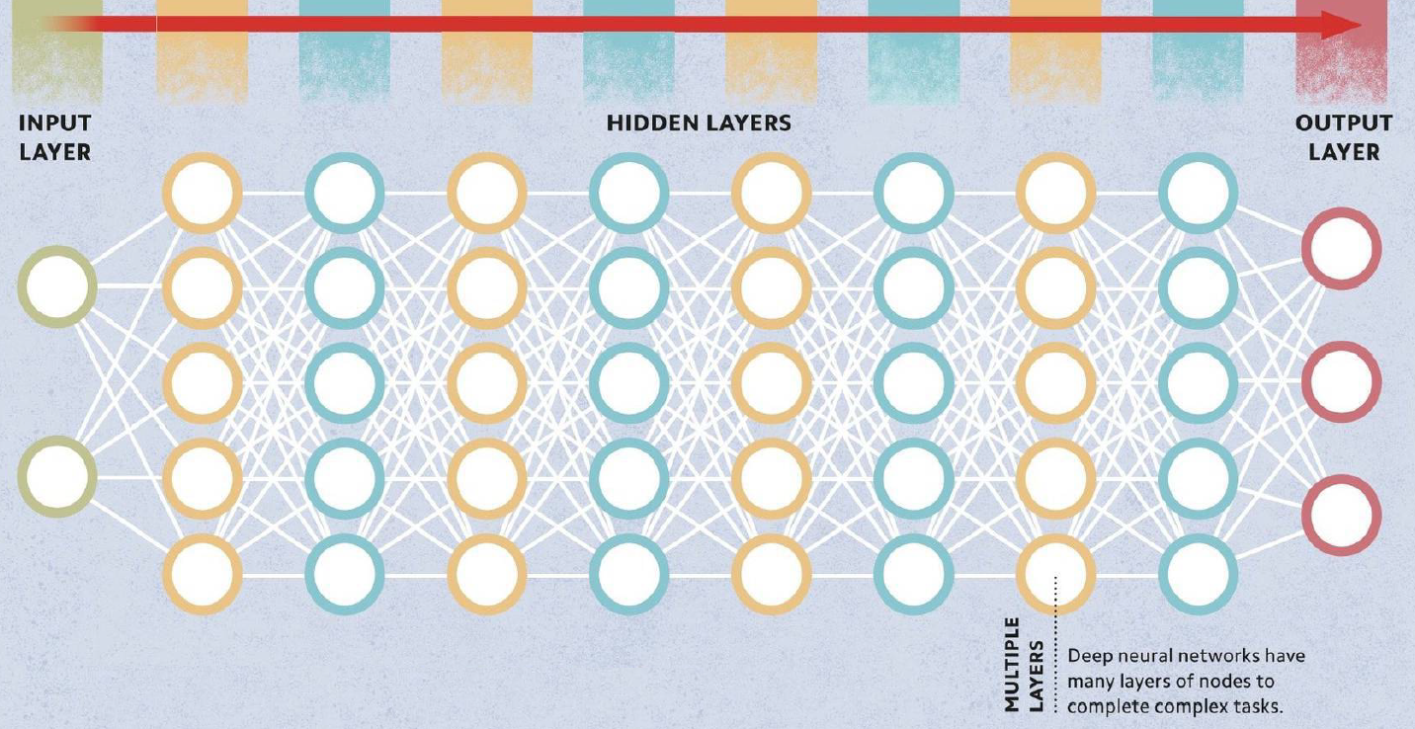

Slide 35
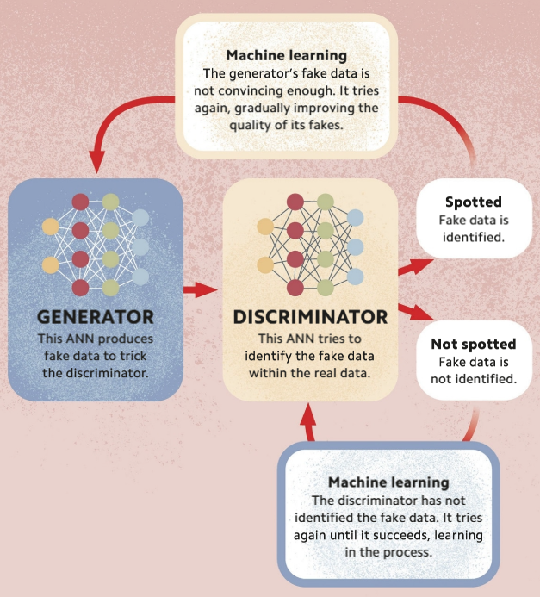
Al VS Al - Generative Adversarial Network
A generative adversarial network (GAN) is a machine-learning model that uses two competing artificial neural networks.
One ANN, the "generator", uses unlabeled training data to create new fake data that it supplies to the second ANN—the "discriminator.“
The discriminator aims to identify the fake data.
This process continues until the generator can make convincing fake data.

Slide 36
PROCESSING VISUAL DATA - CONVOLUTIONAL NEURAL NETWORKS
A convolutional neural network (CN N) is a type of deep neural network that is similar to the structure of the visual cortex
CNNs are effective tools for computer vision, since they can be taught to recognize features in input images, such as the pointed ears of cats.
There are three types of layers in a CNN
  The first type performs a function called a "convolution," which allows features in an image to be detected. These layers first extract low-level features (lines and edges), before extracting higher-level features (shapes). They work by passing a filter over the image that creates a "map" of the location of each feature on the image.
  Between each convolution, there is a "pooling" layer, which reduces the complexity of the feature maps.
  The data from these layers is flattened, and then passes through a "classification" layer, which identifies and labels the image.

Slide 37
